Slide 1
Domain-Specific Languages for Hardware In The Loop Testing
By: Graham Power

Slide 2
What Is Hardware In The Loop Testing?
?

Slide 3
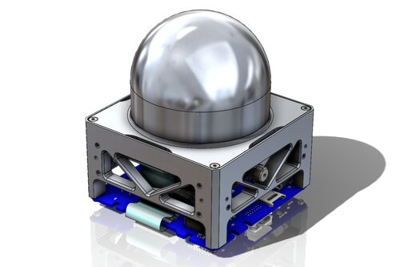
What Is Hardware In The Loop Testing?
Notes:
On MIST we have a board we want to test live with hardware

Slide 4

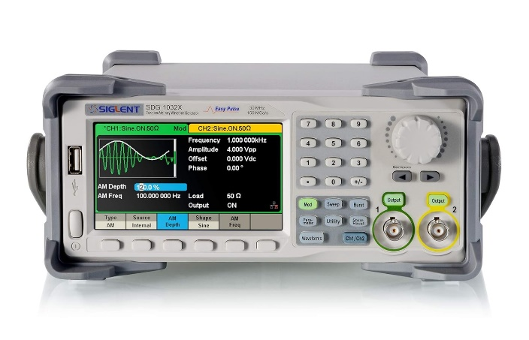
What Is Hardware In The Loop Testing?
Notes:
We connect the inputs & outputs of the board to a test board and we want to drive inputs and compare outputs? How to do this?
currently, testing plans are currently executed manually

Slide 5
What Is Hardware In The Loop Testing?
Notes:
We connect the inputs & outputs of the board to a test board and we want to drive inputs and compare outputs? How to do this?
currently, testing plans are currently executed manually

Slide 6
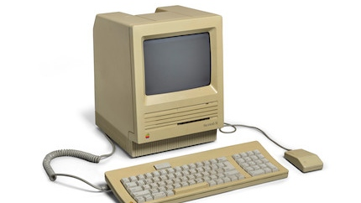
What Is Hardware In The Loop Testing?
?
Notes:
What if instead we could write code?!!

Slide 7
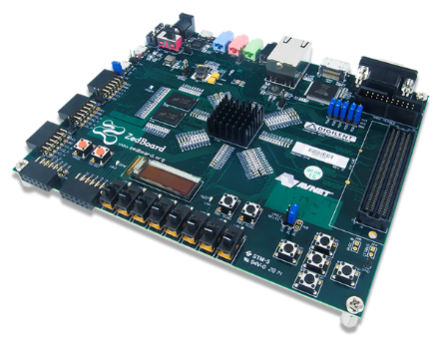
What Is Hardware In The Loop Testing?

Slide 8
What Is Hardware In The Loop Testing?

Slide 9
What Is Hardware In The Loop Testing?

Slide 10
What Is Hardware In The Loop Testing?

Slide 11
So What’s The Problem?
Those with the expertise to test the system rarely know how to write good code
Programmers rarely dabble in radiation physics
So this testing process would have a lot of back and forth

Slide 12
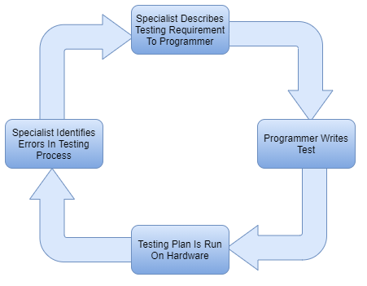
HIL Process Flow
Notes:
The process of HIL would go something like this:

Slide 13
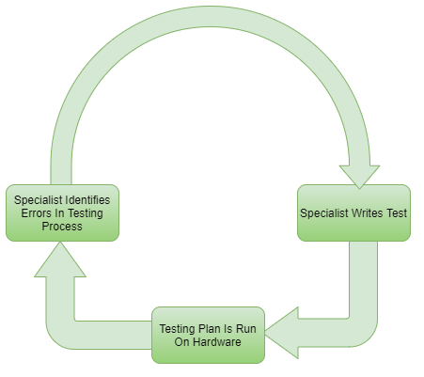
HIL Process Flow
Notes:
What if we could remove the programmer??

Slide 14
Enter Domain Specific Languages
Let’s make a DSL that write’s like a test plan
The DSL can then generate C code automatically
Now the domain specialists don’t need to write complex code!

Slide 15
What Would An HIL DSL Look Like?
Drive Inputs
Record Outputs
Acceptance Criteria
Signal Comparison
Test Outputs
David Thonnessen, Hardware-in-the-Loop Testing of Industrial Automation Systems Using PLC Languages
Thonnessen & Reinker, A Concept for PLC Hardware-in-the-loop Testing Using an Extension of Structured Text
Notes:
David Thonnessen, in his PhD thesis, describes HIL DSL as having 5 main steps…
Setting signals is fairly easy, so for this project, I’ll be focusing on the signal comparison problem

Slide 16
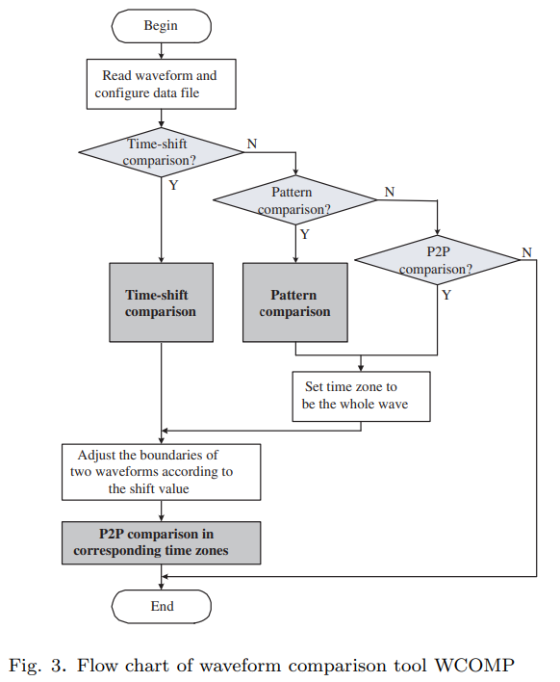
Signal Comparison: Related Work
WCOMP: Waveform Comparison Tool for Mixed-signal Validation Regression in Memory Design
Proposed 3 comparison algorithms
These algorithms are all for PWM-like pulse comparisons

Slide 17
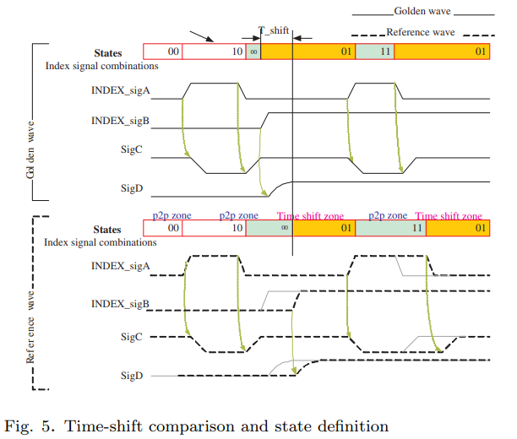
Signal Comparison: Related Work

Slide 18
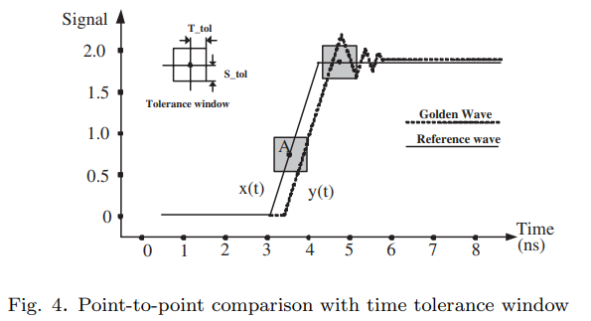
Signal Comparison: Related Work

Slide 19
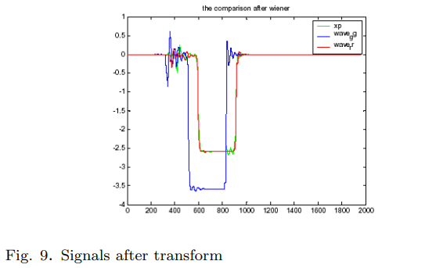
Signal Comparison: Related Work
(For Pattern Comparison Algorithm)

Slide 20
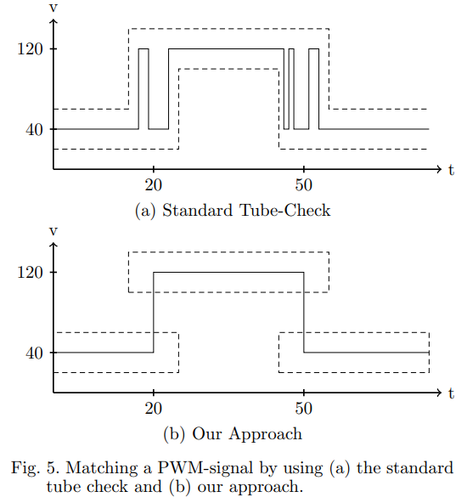
Signal Comparison: Related Work
Matching Discrete Signals for Hardware-in-the-Loop-Testing of PLCs
Proposed Set-Match
An algorithm for matching discrete signals without the downfalls of P2P

Slide 21
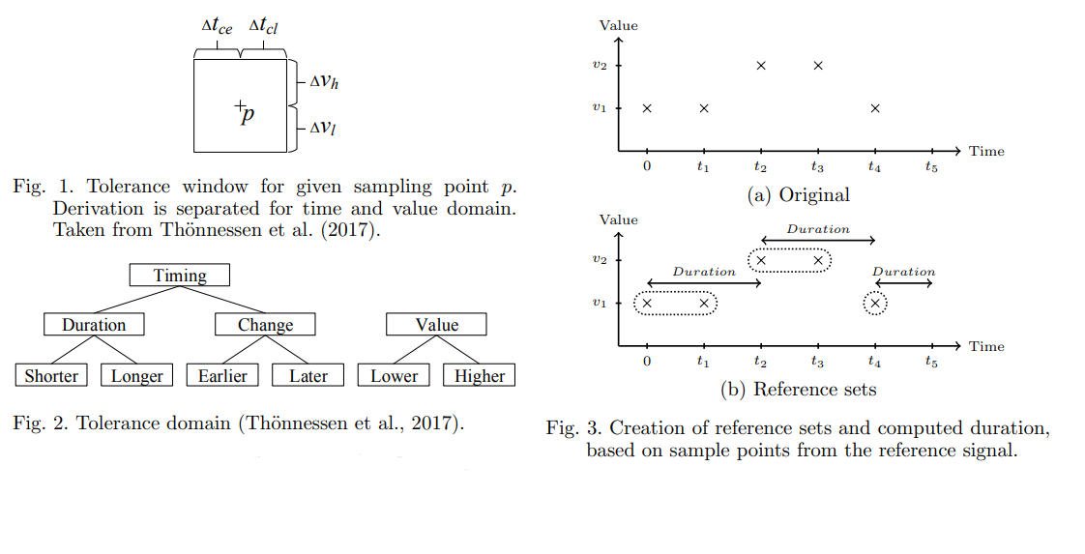
Signal Comparison: Related Work

Slide 22
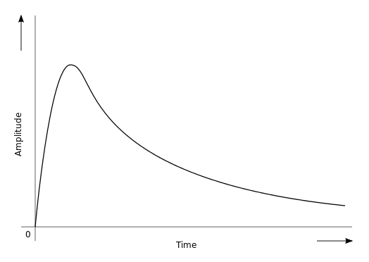
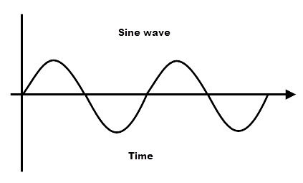
What’s Missing?
All these papers compare digital or close-to-digital signals
On some boards, we have fully analog signals:
Sine Waves
Exponential Pulses
Notes:
We want to find algorithms for a wider range of signals (constant, pwm, sine, sawtooth, triangle, trapezoid)

Slide 23
How Can We Match Analog Signals?
Ideally with a binary matching algorithm
This is usually unrealistic
So what options do we have?
The algorithms discussed in previous works (pipe, rtol, etc…)
Basic error measurements (mse, rmse, mae)
Distance Measurements (Euclid, Frechet)

Slide 24
Let’s See How These Works For Simple Signals

Slide 25
Pt1: Accuracy
What is the ideal matching algorithm?
A binary one, it either matches or it doesn’t
We have the algorithms discussed in papers above (pipe, rtol…)
We have basic errors like mse, rmse, mae
We have distance measurements like Euclid, frechet
Show comparison plots for: (constant, pwm)
But these signals cannot account for 2 key features in our signals
1: Time invariance
2: Unpredictable exponential fall

Slide 26
Plan
Signal Comparison Related work:
WCOMP paper
Set Match paper
All of these papers focus on matching of simple digital signals (PWM type), mainly for digital ASIC testing
We want to find algorithms for a wider range of signals (constant, pwm, sine, sawtooth, triangle, trapezoid)
The next problem:
On MIST, our board measures radiation events, which produce exponential pulses
While these pulses can be digitized, they are far from basic PWM
More-over, the pulses are driven by this equation, where alpha and beta are values which we don’t necessarily know at the time of testing
Can we find a set of signal matching algorithms that are both accurate and fast?

Slide 27
Pt1: Accuracy
Time invariance can be fixed by CrossCorrelation Shifting
Basically we slide one signal across the other, and for each point calculate the dot product. We then shift the sliding signal by the index of the highest dot product.
This allows us to align the signals in time before using a comparison algorithm to ensure time invariance
Show comparison for: (sine, sawtooth, triangle, trapezoid)
Unpredictable exponential fall is a little harder to fix
We need an algorithm that allows to a signal to be “faster” in the time domain the one we compare it against
Enter Dynamic Time Warping

Slide 28
Dynamic Time Warping
Explain Dynamic Time Warping
Show why its needed for exponential pulses
So clearly we need DTW, but theres one problem, its pretty slow
Can we accelerate it?
Show the initial algorithm
3 stages, initialize array, gen costs, walk costs
Has an n^2 memory footprint
Has an 2n^2+2n runtime
Walking is inherently serial with speculative indexing

Slide 29
Pt2: Accelerate DTW
How can we accelerate this?
Pt A: Basic accelerations
Like in GEMM, the result is not dependant on the order of the loops
In initialization, we don’t actually need initialize the entire array
Reduce the bit width of cost matrix
Exact result isn’t important, only that the results are comparable relative to one another
Results of Pt A

Slide 30
Pt2: Accelerate DTW
Pt B: Multithreading
Can we multithread the initialization or cost gen?
Initialization is entirely independent, so multithreading is trivial
Cost gen unfortunately has dependencies, diagonals require the results of the entire upper matrix (Show block A)
We can’t thread the diagonals since one would have to completely finished before another begins (Show block A)
We could however multithread rows and columns dependently (Show block B)
This would allow 2 threads to run together. #0 starts, signals #1 after the first element is calculated, and so on…

Slide 31
Pt2: Accelerate DTW
This introduces a new issue however, row threads have great cache locality, but column threads don’t
What if we reorder the how the matrix is stored in memory to fix this issue?
Now we have good cache locality for both row and column threads
We could also block the matrix and run threads on individual blocks
This would change our data dependencies (show block A)
This would also require a different matrix memory mapping to keep cache locality high
We are no longer restricted to only 2 threads
This blocking and thread performance comparison is yet to be implemented but I aim to for the end of the project

Slide 32
Questions?

Slide 33
References
D. Thönnessen, “Hardware-in-the-Loop testing of industrial automation systems using PLC languages,” Dissertation, RWTH Aachen University, 2021, doi: 10.18154/RWTH-2021-08705
D. Thönnessen, N. Reinker, S. Rakel and S. Kowalewski, "A concept for PLC hardware-in-the-loop testing using an extension of structured text," 2017 22nd IEEE International Conference on Emerging Technologies and Factory Automation (ETFA), Limassol, Cyprus, 2017, pp. 1-8, doi: 10.1109/ETFA.2017.8247580.

